Slide 1
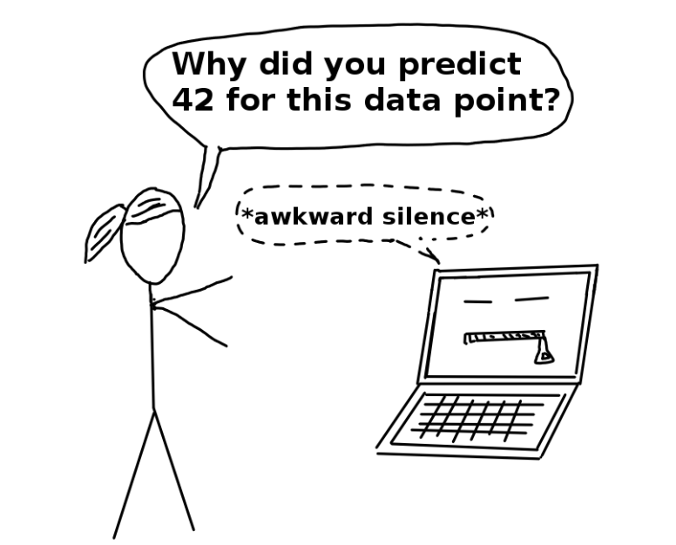
Transparency Product – Why?
If a machine learning model performs well, why do we not just trust the model and ignore why it made a certain decision?
Human curiosity and learning
Q
1.1 Which variables is most important and
1.2 how each variables contribute to the final prediction
Safety measures and testing
Self-driving car(100% no error)
racists that discriminate against underrepresented groups
(As only represented population is present for the model)
Q
Is any variables correlated with protected variables that lead to fairness concerns?
Social acceptance
Q. Why I get this credit score? How can I improve it?
Models debugged and audited
Machine learning Models can only be debugged and audited when they can be interpreted
Q.
How can I fine-tune the model to avoid overfit/underfit
Further simplify the model – Over 1000 features test out for Telco

Slide 2



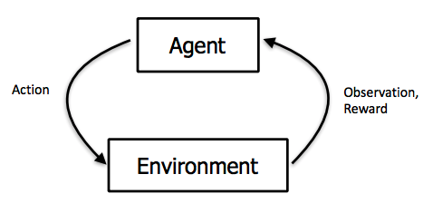
Machine Learning - Learning Approaches
Machine Learning is a process for computers to learn without being explicitly programmed.
Supervised Learning: Learning with a labeled training set
E.g.: Classification of risky and non–risky customer based on past data
Supervised learning
Unsupervised Learning: Discovering patterns in unlabelled data
Example: cluster similar customers based on demographics
Unsupervised learning
Reinforcement Learning: learning based on feedback or reward
Example: learn to play chess by winning or losing
Reinforcement Learning

Slide 3
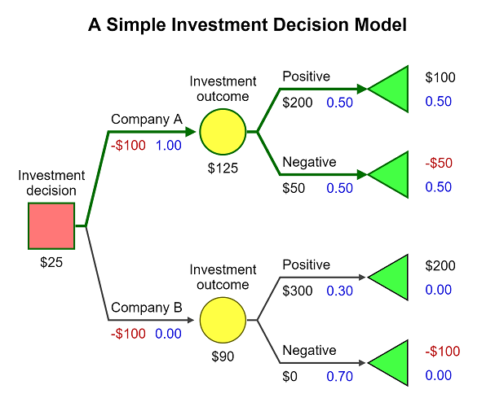
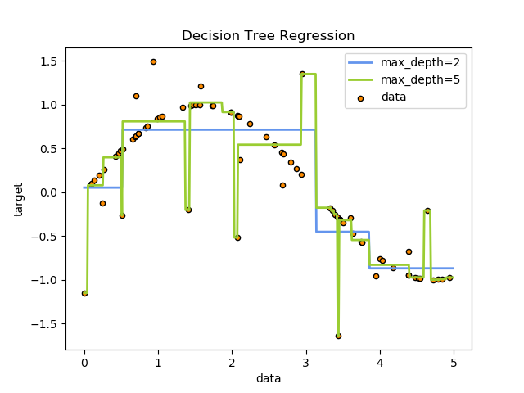
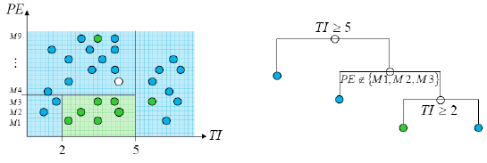
Tree Based Algorithms: Decision Tree / CART
Illustrative Decision Tree
CART – Classification and Regression Tree
Advantages
Disadvantages
Applicable to both classification and regression problems
No assumptions on the data structure
Can be applied to large datasets
Handles missing data effectively
Tree structure gives valuable insights into the variables and model:
Accuracy - current methods, such as support vector machines and ensemble classifiers often have 30% lower error rates than CART
Instability – if we change the data a little, the tree picture can change a lot. So, the interpretation is not as straightforward as it appears
Decision Boundaries
Today, we can do better!
Splits are chosen according to a purity measure
Notes:
A decision tree is a flowchart-like structure in which each internal node represents a "test" on an attribute, each branch represents the outcome of the test, and each leaf node represents a class label
Decision rules : The decision tree can be linearized into decision rules, where the outcome is the contents of the leaf node, and the conditions along the path form a conjunction in the if clause. In general, the rules have the form:
if condition1 and condition2 and condition3 then outcome.
Are simple to understand and interpret
Allow the addition of new possible scenarios.
Help determine worst, best and expected values for different scenarios.
Use a white box model. If a given result is provided by a model.
Can be combined with other decision techniques.
They are often relatively inaccurate.
Calculations can get very complex, particularly if many values are uncertain and/or if many outcomes are linked.
Over fitting
In decision trees, the goal is to tidy the data. You try to separate your data and group the samples together in the classes they belong to. You know their label since you construct the trees from the training set. You maximize the purity of the groups as much as possible each time you create a new node of the tree (meaning you cut your set in two). Of course, at the end of the tree, you want to have a clear answer.
At each step, each branching, you want to decrease the entropy, so this quantity is computed before the cut and after the cut. If it decreases, the split is validated and we can proceed to the next step, otherwise, we must try to split with another feature or stop this branch.
This step by step approach is called a greedy approach. Entropy is used to calculate the homogeneity of a sample
Information gain is often used to decide which of the attributes are the most relevant, so they can be tested near the root of the tree. One of the input attributes might be the customer's credit card number.
However, in decision trees, a weighted sum of entropies is computed
By using entropy, decision trees tidy more than they classify the data.

Slide 4
Tree Based Algorithms: Ensemble of Trees
Ensemble algorithms are like Crowdsourced machine learning algorithms:
Take a collection of simple or weak learners
Combine their results to make a single, better learner
Popular techniques for creating Tree based Ensemble models
Bagging
Boosting
Each model trained in parallel; models are combined using voting / averaging
Train each model with a random training set
Repeatedly draw n samples from D
For each set of samples, estimate a statistic
The bootstrap estimate is the mean of the individual estimates
Used to estimate a statistic (parameter) and its variance
Incremental; each learner tries to correct the errors form the previous learner
Randomly select samples from data and train weak learner C₁
Select stratified sample (C₁ error-rate=50%) to obtain D₂ and train weak learner C₂
Select all samples from data that C₁ and C₂ disagree on and train weak learner C₃
Final classifier is vote of weak learners
Notes:
A decision tree is a flowchart-like structure in which each internal node represents a "test" on an attribute, each branch represents the outcome of the test, and each leaf node represents a class label
Decision rules : The decision tree can be linearized into decision rules, where the outcome is the contents of the leaf node, and the conditions along the path form a conjunction in the if clause. In general, the rules have the form:
if condition1 and condition2 and condition3 then outcome.
Are simple to understand and interpret
Allow the addition of new possible scenarios.
Help determine worst, best and expected values for different scenarios.
Use a white box model. If a given result is provided by a model.
Can be combined with other decision techniques.
They are often relatively inaccurate.
Calculations can get very complex, particularly if many values are uncertain and/or if many outcomes are linked.
Over fitting
In decision trees, the goal is to tidy the data. You try to separate your data and group the samples together in the classes they belong to. You know their label since you construct the trees from the training set. You maximize the purity of the groups as much as possible each time you create a new node of the tree (meaning you cut your set in two). Of course, at the end of the tree, you want to have a clear answer.
At each step, each branching, you want to decrease the entropy, so this quantity is computed before the cut and after the cut. If it decreases, the split is validated and we can proceed to the next step, otherwise, we must try to split with another feature or stop this branch.
This step by step approach is called a greedy approach. Entropy is used to calculate the homogeneity of a sample
Information gain is often used to decide which of the attributes are the most relevant, so they can be tested near the root of the tree. One of the input attributes might be the customer's credit card number.
However, in decision trees, a weighted sum of entropies is computed
By using entropy, decision trees tidy more than they classify the data.

Slide 5
Gradient Boosting: Bias and Variance Reduction
Depth 5-10
…
Random forest use 100’s of deep, large trees:
100k’s of nodes
Bias reduction
through depth
10’s of trees
Variance reduction through the ensemble aggregate
Depth 3-7
…
Boosted decision trees use 1000’s of shallow, small trees:
1k’s of nodes
1000’s of trees
Bias reduction through boosting – variance already low

Slide 6
Decision Boundary: Decision Tree vs. Neural Network Learning
vs.
single-layer perceptron
multi-layer network
Decision Tree
Neural Network Learning
Interpretable Models:
1. Linear Regression
2. Logistic Regression
3. GLM, GAM and more
4. Decision Tree
5. Decision Rules
Black-box Models:
1. Random forest model
2. gradient boosting
3. Neural Network Learning

Slide 7
Transparency Product
Developing a tool for integrating transparency best practices into the ML model development process as standard using a framework of Explainability tools and best practice guidelines
Capturing the source of data, collection/sampling process, exclusions, biases, etc. (`Datasheet for data`)
Tracebility
Process Implementation –Require new processes / best practices to be introduced in the AL / ML development cycle to align with FEAT principles
Global Explainability
Local Explainability
Feature Explainability
Model Explainability
Product Development –Require tools / products to be created that can facilitate quick and easy computation of transparency metrics
Explainability
Data Dictionary
Feature Importance
PDP / SHAP / Permutation Feat Imp.
Feature Interaction
Friedman’s H-Statistic
SHAP
ALE
Explain Prediction /
SHAP / ICE / Counterfactual / Reason Codes
Simulate scenarios
Surrogate Models AutoML Linear
Compare Records
Report model capability, design, working. Explain performance measures and guidelines for responsible use
Submodules required with recommended open-source tools to be used in the Explainability module
Reporting
Notes:
Process vs Product
Interpretability for Analytics Teams vs Business/Product Lead vs End Users vs CXO
Stages of development
Questions
Feature:
Relative Importance(Table); Direction(Feature vs Target Rate Line Chart)
Feature Interaction: Why 2 correlated features are present in model
Model
??
Prediction

Slide 8
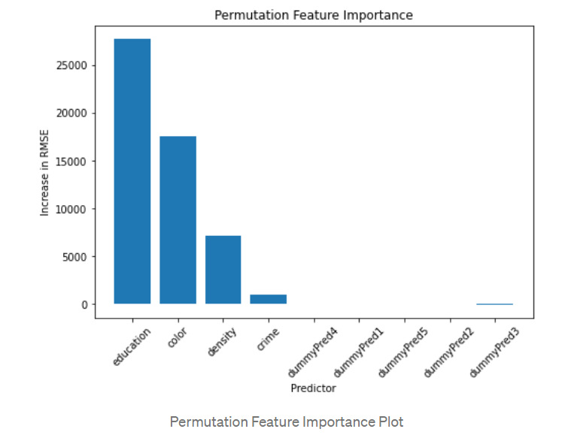
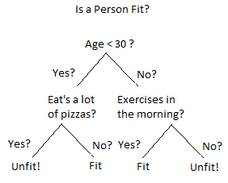
Transparency Product – Feature & Model Explainability
Q1 – Which variables is most important (Global).
Decision Tree
Black Box Model
Variable importance: whether that variable was selected to split on during the tree building process, and how much the squared error (over all trees) improved (decreased) as a result.
.
Permutation feature importance: measures the increase in the prediction error of the model after we permuted the feature’s values
.
Most important variables that reduce the predict error most

Slide 9
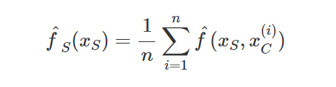
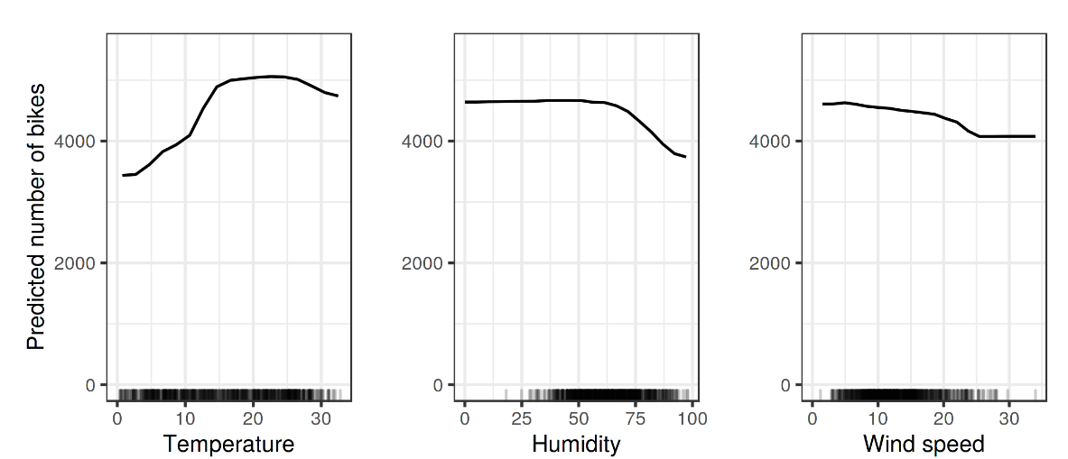
Transparency Product – Feature & Model Explainability
Q1.2 – How it contribute to the final prediction(Global)
Decision Tree
Black Box Model
Self explained on how prediction is finally made
.
Partial Dependence Plot (PDP): the marginal effect one or two features have on the predicted outcome of a machine learning model
.
Most important variables that reduce the predict error most
Actual feature values from the dataset
machine learning model
Given value of features S

Slide 10
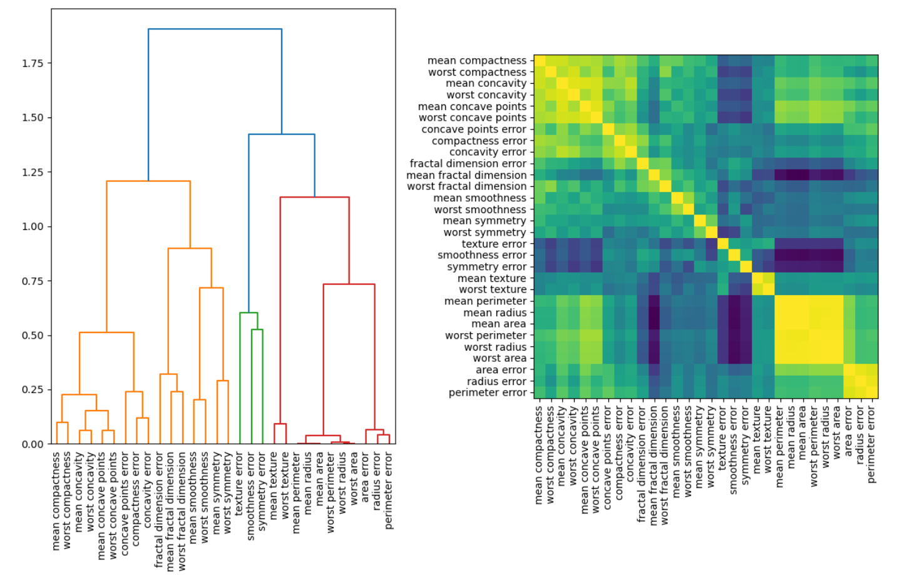
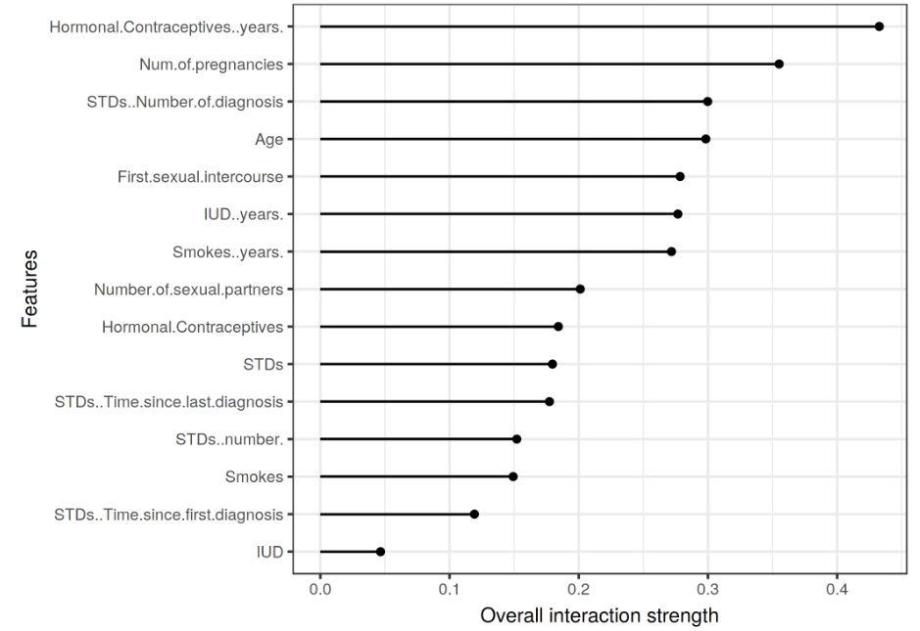
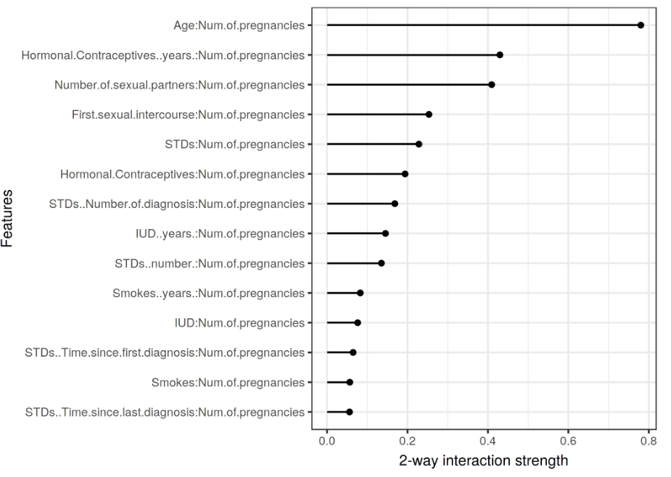
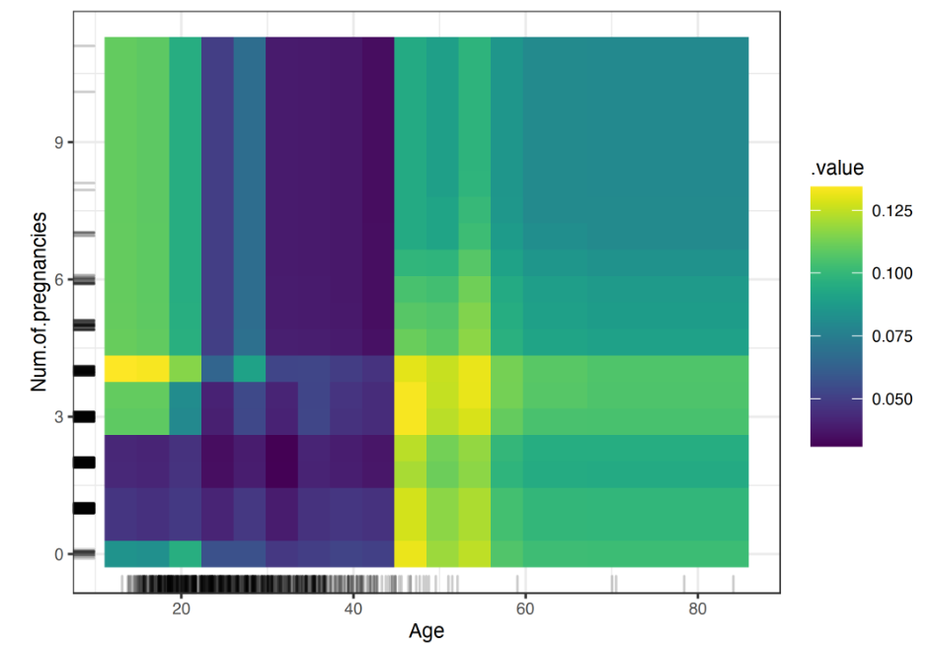
Transparency Product (WIP) – Feature & Model Explainability
Q.2 How variables interaction and its effect on final prediction:
Is any variables correlated with protected variables that lead to fairness/ethnics concerns?
Is the correlation break any model assumption
Can we make our model simpler by only use 1 variable from a correlation cluster.
Here we propose 3 technique combined to evaluate.
Variables Cluster. Based on different cutoff of variables correlation, variables cluster into different group. This can give us a view on how variables correlated each other. Usually, correlation large than 0.5 will consider as a strong correlation.
Friedman’s H-statistic: Then for the high correlated variables, we can check the value of H-statistic on whether this correlation contribute a lot in the final prediction. If H-statistic is10%, then it means 10% of variance is explained by this feature interaction with other variables. There don’t have rule of thumbs for H-statistic, but general 10%-20% is relatively low and above 30% then we may should pay attention.
2D PDP plots. Show the combined effect of the correlated features. (Kindly notice if we are only interested in the interaction effect, we should look at the second-order effects on ALE 2D plots, because the PDP plots is focus on total effect which already mixes the main effects into the plot)
Variables Cluster:.
Friedman’s H-statistic
2D PDP plots:

Slide 11
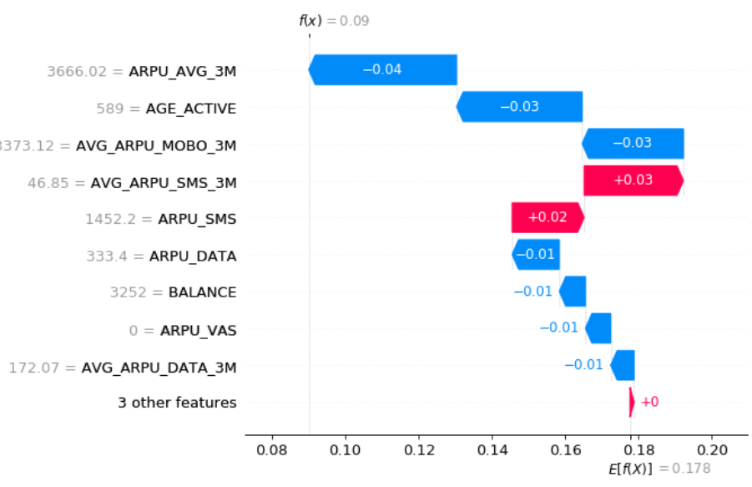
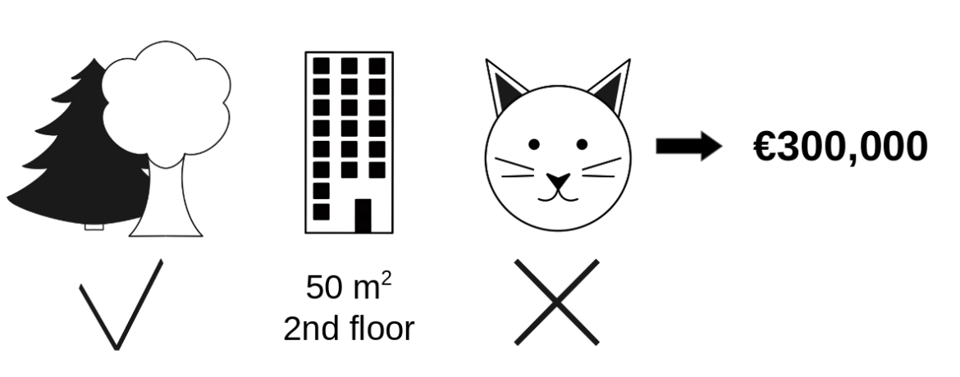
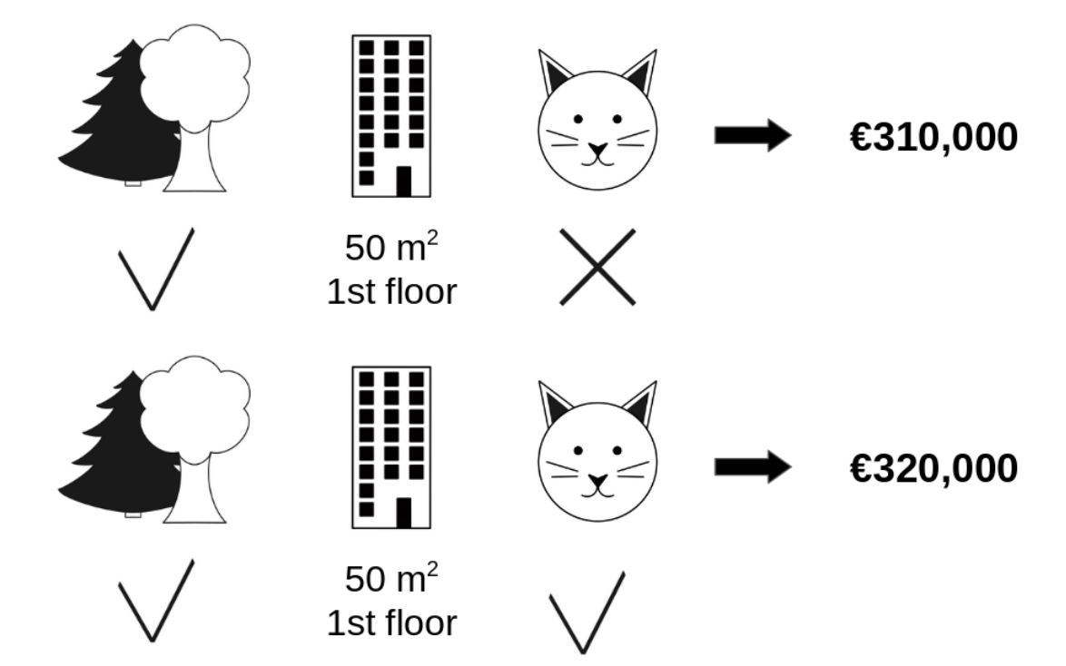
Transparency Product– Record / Prediction Explainability
Example: a machine learning model to predict apartment prices. It predicts €300,000 at a record:
has a park nearby
has an area of 50 m² and is located on the 2nd floor
cats are banned:
The average prediction for all apartments is €310,000. How much has each feature value contributed to the prediction compared to the average prediction?
Q3 – Why I get this credit score – Shapley Values
We repeat this computation for all possible coalitions. The Shapley value is the average of all the marginal contributions to all possible coalition
Find a different coalitions

Slide 12
Transparency Product– Record / Prediction Explainability
Global Explainability
Local Explainability
Predict Model + Model data
Predict Model + Model data
Which variables is important?
Yes: Permutation feature importance > 0
What are the top reasons for assigning a higher (or lower) score for this record?
No: Permutation feature importance = 0
Important Variables
Not Important Variables
Shap Value
Is this important variables correlated with other variables?
How this record compare to the whole sample
Yes: variables cluster show a correlation> 0.5
No: variables cluster show a correlation<= 0.5
High Correlated Variables
Independent Variables
Shap effect on each instance
Is this correlation contributing to final prediction?
No: H-statistic <=30%
How single variables contribute to the final prediction
What features does customer / record X need to improve in order to improve their score by Y points
Yes: H-statistic >30%
How this interaction contribute to the final prediction
ALE plot
counterfactual explanation
Does all sample behave consistently across the whole sample?
2D PDP plots
Individual Conditional Expectation (ICE)
Notes:
Process vs Product
Interpretability for Analytics Teams vs Business/Product Lead vs End Users vs CXO
Stages of development
Questions
Feature:
Relative Importance(Table); Direction(Feature vs Target Rate Line Chart)
Feature Interaction: Why 2 correlated features are present in model
Model
??
Prediction

